Slide 1
Physics 3 – Oct 31, 2019
Reminder: Your first draft for your IA Project
Is due today. It should include
Introduction explaining why you picked this
expt/topic
2) Background explaining all that is needed
to understand the physics involved and/or the
methods used and what your IV and DV will be
3) Procedure a proposed methodology
Explaining how your IV and DV will be measured and an expected schedule for performing trials.
30 pt assignment – graded only on completion
and punctuality. Get’er done.
Do Now: P3 Challenge –
The displacement of a particle executing SHM is given by
x = – 6.0 sin (4t) where x is in cm and t is in seconds.
Determine a) the amplitude, b) the period, c) the frequency

Slide 2
Objectives/Agenda/Assignment
Objective:
4.4 Wave optics
Agenda:
Homework Review #25-28
Diffraction
Path difference
Double Slit interference
Assignment: Single and Double Slits WS

Slide 3
Diffraction
When waves of a given wavelength encounter a an opening (aperture) that is either of a similar magnitude to the size of its wavelength or something smaller, the wavefronts get bent by passing through the aperture.
The smaller the aperture, the more bending, tending toward creating a point source of circular waves for extremely small apertures compared to wavelength.

Slide 4
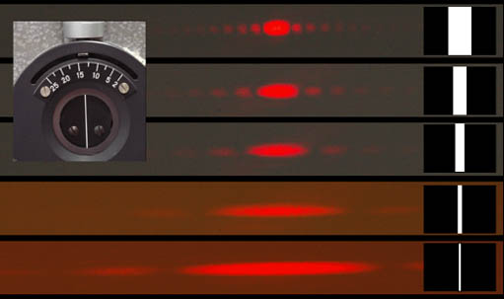
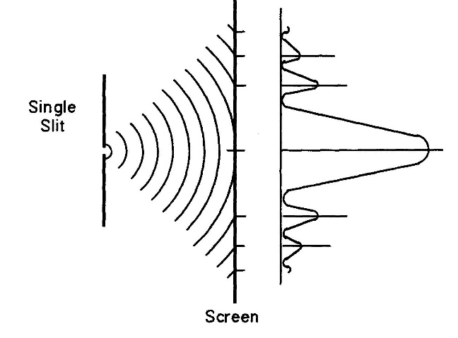
Single slit diffraction pattern
Light from a single slit creates a complex diffraction pattern. That varies depending on the slit width.
The key features are a) the perpendicular direction of the screen to the slit and b) the distance to the first minimum /dark spot .

Slide 5
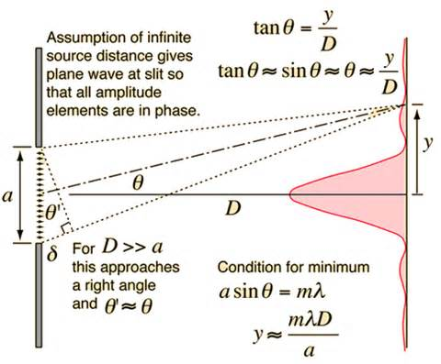
Single slit diffraction pattern creation
Consider two light beams, one emerging from each edge of the slit.
The difference in the distance to a given point on the screen y units away from the center is called the path difference, $δ$ delta = b sin  = n
b
b
b

Slide 6
Single slit diffraction pattern creation
For two sources of light with the same frequency and in phase (as the two sides would be), there will be constructive interference when the path difference is some multiple of the wavelength.
$δ=nλ$ where n is an integer (IB uses n, world uses m)
There will be destructive interference when the path difference is some multiple and a half of the wavelength.
$δ=(n+\frac{1}{2})λ$
b
b
b

Slide 7
Single slit diffraction pattern creation
Consider the small triangle. $δ$ can be expressed in terms of slit width b and the angle $θ$.
$δ=bsinθ$
As long as the distance to the screen D is large compared to the slit width b, then the angles shown will be equal and the two right triangles shown will be similar and the angle will be very small.
b
b
b

Slide 8
Single slit diffraction pattern creation
At small angles $sinθ≈tanθ$
$δ=\frac{by}{D}=nλ$ solving for y gives $y=\frac{mλD}{b}$
When n=1, y is the distance from the central maximum to the first minimum.
2y is the width of the central maximum bar of light.
b
b
b

Slide 9
Single slit diffraction pattern creation
IB uses the following notation:
b = the width of a single slit
$bsinθ=nλ$ condition for minimum (counter intuitive ….consider light from middle path diff)
D = distance from slit to screen is large so angle is small and sin  =  $bθ=nλ$
y is distance from center of pattern to the first minimum
Angle to first minimum given by  = $λ/b$ = y/D
Width of central maximum = 2y

Slide 10
Problems
Red light with a wavelength of 752 nm passes through a single slit with a width of 1.20 x 10⁻⁶ m creating an interference pattern on a screen 0.750 m away.
What is the distance between the central maximum and the first minimum on the screen?
What is the angle between the central maximum and the first minimum?

Slide 11
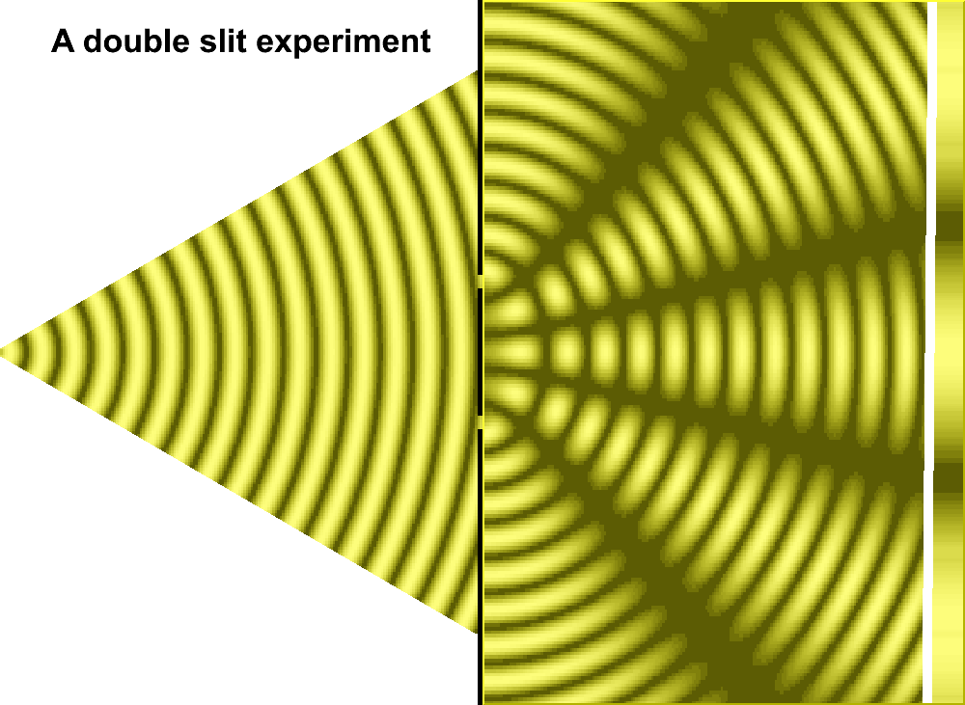
The double slit experiment
https://www.youtube.com/watch?v=Iuv6hY6zsd0 A modern take on Young’s original double slit experiment with sunlight.
Creates an interference pattern with bright and dark fringes.

Slide 12
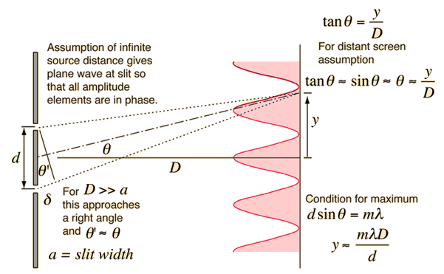
Double slit interference pattern creation
Same assumptions as single slit diffraction. (see image)
The distance between the central bright spot and the next bright spot is called the fringe spacing, y.
For IB, fringe spacing is given by s and calculated as
$s=\frac{λD}{d}$ where D is the distance to the screen and d is the distance between the slits
b

Slide 13
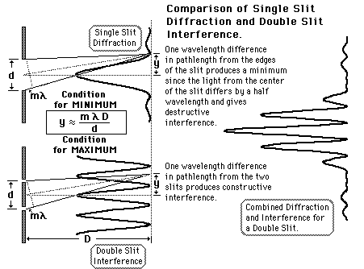
Comparing one and two slits
You’ll notice that a real double slit display shows characteristics of both diffraction based on slit width and the interference based on the distance between slits. (shown on the right.)
The same equation applies to both, but calculates different things.
One slit is a minimum condition.
Two slits is a maximum condition.

Slide 14
Problems
Red light with a wavelength of 752 nm passes through a pair of vertical 1.30 x 10⁻⁵ m slits with a separation of 6.20 x 10⁻⁵ m creating an interference pattern on a screen 0.750 m away. (Watch units)
What is the distance between the central maximum and the third bright fringe to the side?

Slide 15
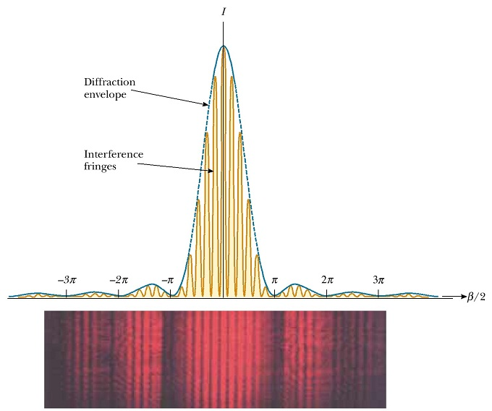
Single and Double Slit Review

Slide 16
Exit slip and homework
Exit Slip – What is the width of the central maximum of the diffraction pattern produced on a screen 1.25 m away when red light with a wavelength of 735 nm is passed through a single 25 μm slit?
What’s due? (homework for a homework check next class)
Single and Double Slits Worksheet
What’s next? (What to read to prepare for the next class.
Read IB 9.3, p182 – 189

